Slide 1

Chapter 25 – XML

Slide 2

Chapter Goals
To learn to use XML elements and attributes To understand the concept of an XML parser To read and write XML documents
To design Document Type Definitions for XML documents

Slide 3
XML Tags and Documents
XML: Extensible Markup Language.
Lets you encode complex data in a form that the recipient can parse easily.
Is independent from any programming language.

Slide 4
Advantages of XML
Example: encode product descriptions to be transferred to another computer.
Naïve encoding:
Toaster 29.95
XML encoding of the same data:
<product>
<description>Toaster</description>
<price>29.95</price>
</product>
XML files are readable by both computers and humans.

Slide 5
Advantages of XML
XML formatted data is resilient to change. It is easy to add new data elements.
Old programs can process the old information in the new data format. In the naïve format a program might think the new data element is the name of the product:
Toaster 29.95
General Appliances
When using XML it is easy to add new elements:
<product>
<description>Toaster</description>
<price>29.95</price>
<manufacturer>General Appliances</manufacturer>
</product>

Slide 6
Similarities Between XML and HTML
Both use tags.
Tags are enclosed in angle brackets.
A start-tag is paired with an end-tag that starts with a slash / character.
HTML example:
<li>A list item</li>
XML example:
<price>29.95</price>

Slide 7
Differences Between XML and HTML
XML tags are case-sensitive.
<LI> is different from <li>.
Every XML start-tag must have a matching end-tag. A tag that ends in /> is both a start- and end-tag:
<img src="hamster.jpeg"/>
XML attribute values must be enclosed in quotes:
<img src="hamster.jpeg" width="400" height="300" />

Slide 8
Differences Between XML and HTML
HTML describes web documents.
XML can be used to specify many different kinds of data.
VRML uses XML syntax to describe virtual reality scenes.
MathML uses XML syntax to describe mathematical formulas.
Use the XML syntax to describe your own data.
XML does not tell you how to display data.
It is a convenient format for representing data.

Slide 9
Structure of an XML Document
An XML data set is called a document. A document starts with a header:
<?xml version="1.0"?>
Data are contained in a root element:
<?xml version="1.0"?>
<invoice>
more data
</invoice>
A document contains elements and text.

Slide 10
Structure of an XML Document
An XML element has one of two forms:
<elementName> content </elementName>
or:
<elementName/>
The contents can be elements or text or both.

Slide 11
Structure of an XML Document
An example of an element with both elements and text (mixed content):
<p>Use XML for <strong>robust</strong> data formats.</p>
The p element contains:
The text: "Use XML for ".
A strong child element.
More text: " data formats."
Avoid mixed content for data descriptions (e.g. our product data). Content that consists only of elements is called element content.

Slide 12
XML Attributes
An element can have attributes.
The a element in HTML has an href attribute:
<a href="http://horstmann.com"> ...</a>
An attribute has a name (such as href) and a value.
The attribute value is enclosed in single or double quotes. An element can have multiple attributes:
<img src="hamster.jpeg" width="400" height="300"/>
An element can have both attributes and content:
<a href="http://horstmann.com">Cay Horstmann's web site</a>

Slide 13
XML Attributes
An attribute is intended to provide information about the element content.
Bad use of attributes:
<product description="Toaster" price="29.95"/>
Good use of attributes:
<product>
<description>Toaster</description>
<price currency="USD">29.95</price>
</product>
In this case, the currency attribute helps interpret the element content:
<price currency="EUR">29.95</price>

Slide 14
Self Check 25.1
Write XML code with a student element and child elements name and id that describe you.
Answer: Your answer should look similar to this:
<student>
<name>James Bond</name>
<id>007</id>
</student>

Slide 15
Self Check 25.2
What does your browser do when you load an XML file, such as the section_2/ items.xml file that is contained in the companion code for this book?
Answer: Most browsers display a tree structure that indicates the nesting of the tags. Some browsers display nothing at all because they can’t find any HTML tags.

Slide 16
Self Check 25.3
Why does HTML use the src attribute to specify the source of an image instead of
<img>hamster.jpeg</img>?
Answer: The text hamster.jpg is never displayed, so it should not be a part of the document. Instead, the src attribute tells the browser where to find the image that should be displayed.

Slide 17
Parsing XML Documents
A Parser is a program that:
Reads a document.
Checks whether it is syntactically correct.
Takes some action as it processes the document.
Two kinds of XML parsers:
Streaming parser: reads XML input one token at a time and reports what it encounters.
Tree-based parser: builds a tree that represents the parsed document that can then be analyzed.

Slide 18
Types of XML Document Parsers
Streaming parser is more efficient for large documents but gives information in bits and pieces.
Tree-based parser is easier to use, giving complete overview of the document.

Slide 19
Java Interface to XML Parser
Document interface describes the tree structure of an XML document.
A DocumentBuilder can generate an object of a class that implements Document interface.
Get a DocumentBuilder by calling the static newInstance
method of DocumentBuilderFactory.
Call newDocumentBuilder method of the factory to get a
DocumentBuilder:
DocumentBuilderFactory factory = DocumentBuilderFactory.newInstance();
DocumentBuilder builder = factory.newDocumentBuilder();

Slide 20
Reading XML Documents From Various Sources
To read a document from a file:
String fileName = ...;
File f = new File(fileName); Document doc = builder.parse(f);
To read from a URL on the Internet:
String urlName = ...;
URL u = new URL(urlName); Document doc = builder.parse(u);
To read from an arbitrary input stream:
InputStream in = ...;
Document doc = builder.parse(in);

Slide 21
Inspecting XML Documents
After the document has been parsed, you can inspect or modify the document.
Easiest way of inspecting a document is by using XPath syntax. An XPath describes a node or set of nodes.
XPath uses a syntax similar to directory paths.

Slide 22
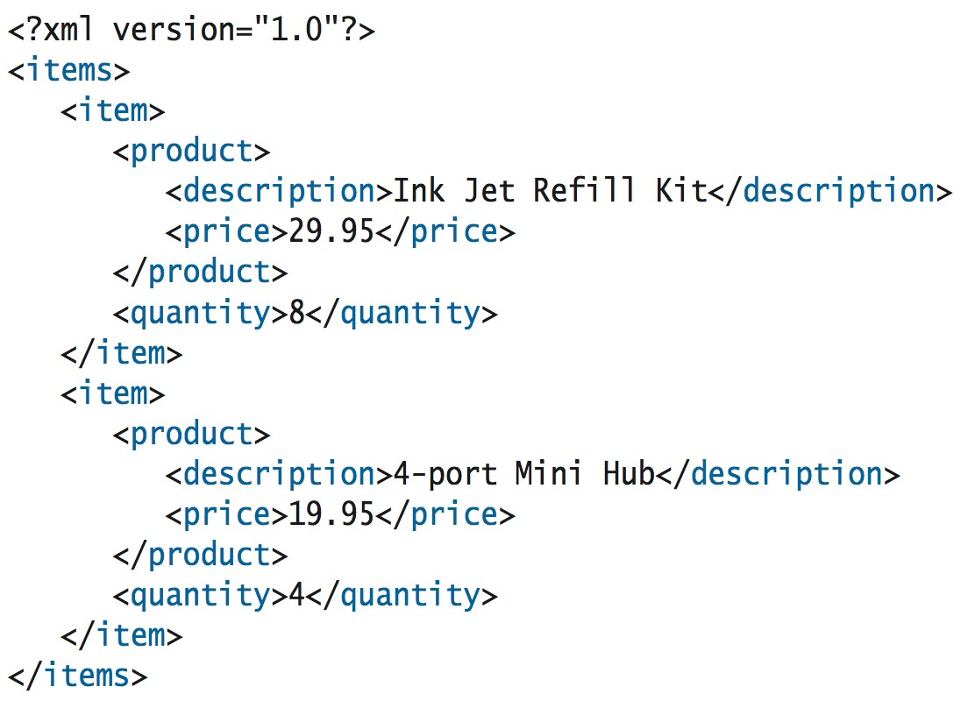
Sample XML Document
Figure 1 A Sample XML Document

Slide 23
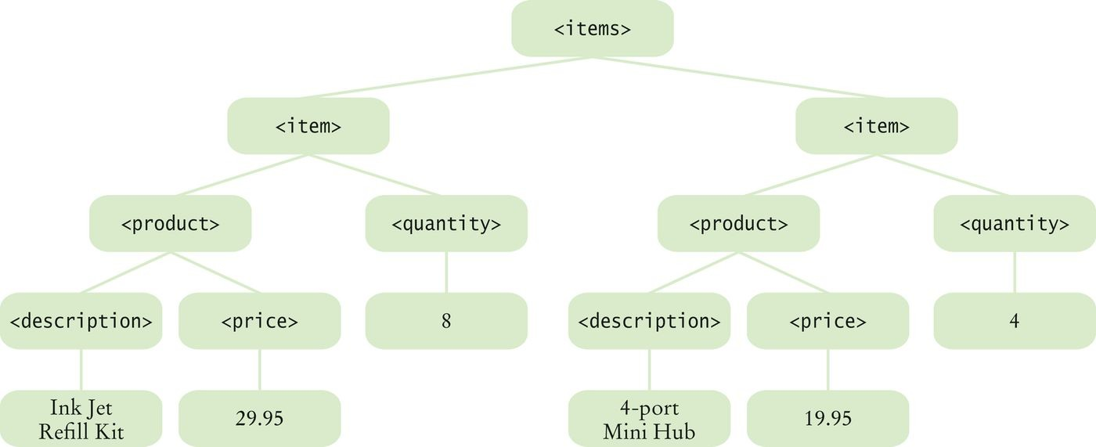
Tree View of XML Document
Figure 2 The Tree View of the Document

Slide 24
Using XPath to Inspect a Document
Consider the following XPath applied to the sample document:
/items/item[1]/quantity
It selects the quantity of the first item (the value 8). In XPath, array positions start with 1.
Similarly, you can get the price of the second product as:
/items/item[2]/product/price

Slide 25
More XPath Syntax
To get the number of items (2), use the XPath expression:
count(/items/item)
The total number of children (2) can be obtained as:
count(/items/*)
To select attributes, use an @ followed by the name of the attribute:
/items/item[2]/product/price/@currency
To find out the name of a child in a document with variable/unknown structure:
name(/items/item[1]/*[1])
The result is the name of the first child of the first item, "product".

Slide 26
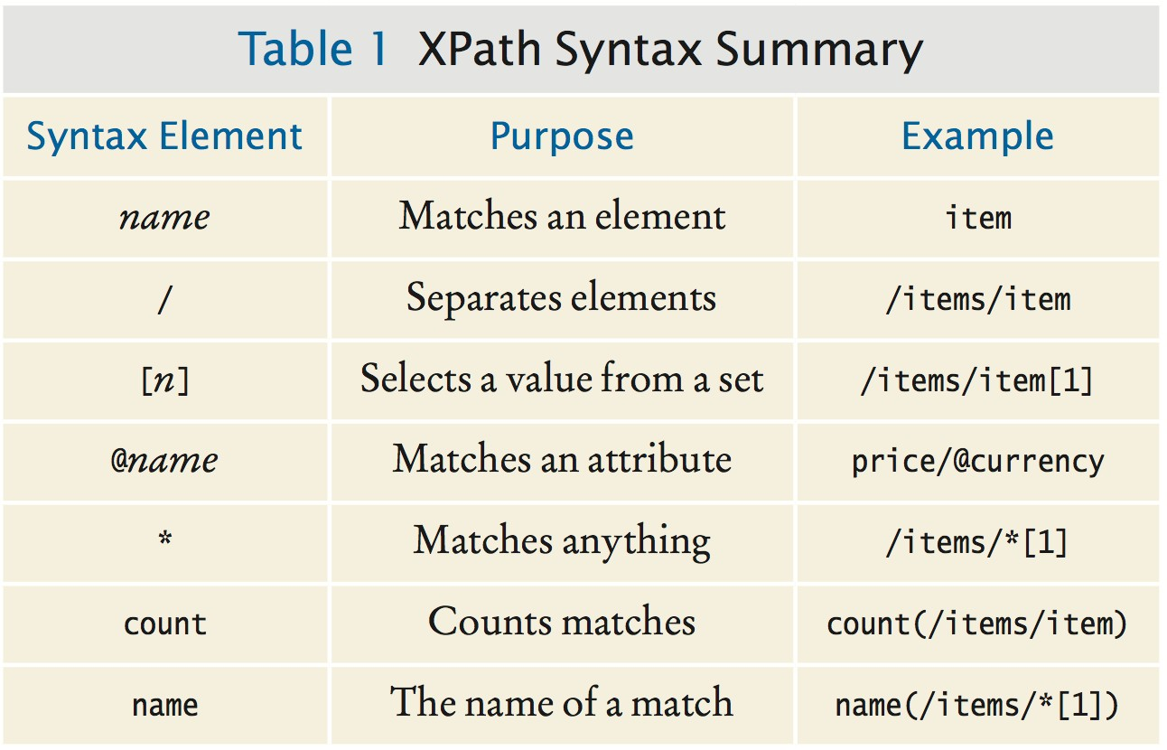
Xpath Syntax Summary

Slide 27
Java XPath API
To evaluate an XPath expression in Java, create an XPath object:
XPathFactory xpfactory = XPathFactory.newInstance(); XPath path = xpfactory.newXPath();
Then call the evaluate method:
String result = path.evaluate(expression, doc);
expression is an XPath expression as a String.
doc is the Document object that represents the XML document. Example:
String result = path.evaluate("/items/item[2]/product/price", doc);
Sets result to the string "19.95".

Slide 28
Parsing XML to Objects
ItemListParser parses an XML document with a list of product descriptions.
Uses LineItem and Product classes.
parse method takes the file name and returns an array list of
LineItem objects:
ItemListParser parser = new ItemListParser(); ArrayList<LineItem> items = parser.parse("items.xml");
ItemListParser translates each XML element into an object of the corresponding Java class.

Slide 29
Parsing XML to Objects
First get the number of items:
int itemCount = Integer.parseInt(path.evaluate( "count(/items/item)", doc));
For each item element, gather the product data and construct a
Product object:
String description = path.evaluate(
"/items/item[" + i + "]/product/description", doc); double price = Double.parseDouble(path.evaluate(
"/items/item[" + i + "]/product/price", doc)); Product pr = new Product(description, price);
Then construct a LineItem object and add it to the items array list.

Slide 30
section_2/ItemListParser.java
import java.io.File;
import java.io.IOException;
import java.util.ArrayList;
import javax.xml.parsers.DocumentBuilder;
import javax.xml.parsers.DocumentBuilderFactory;
import javax.xml.parsers.ParserConfigurationException;
import javax.xml.xpath.XPath;
import javax.xml.xpath.XPathExpressionException;
import javax.xml.xpath.XPathFactory;
import org.w3c.dom.Document;
import org.xml.sax.SAXException;
12
13
14
15
16
17
18
19
20
21
22
23
24
25
26
27
28
29
30
31
32
33
34
35
/**
An XML parser for item lists
*/
public class ItemListParser
{
private DocumentBuilder builder; private XPath path;
/**
Constructs a parser that can parse item lists.
*/
public ItemListParser()
throws ParserConfigurationException
{
DocumentBuilderFactory dbfactory
= DocumentBuilderFactory.newInstance(); builder = dbfactory.newDocumentBuilder(); XPathFactory xpfactory = XPathFactory.newInstance(); path = xpfactory.newXPath();
}
/**
Parses an XML file containing an item list.

Slide 31
section_2/ItemListParserDemo.java
1 import java.util.ArrayList;
2
3 /**
This program parses an XML file containing an item list.
It prints out the items that are described in the XML file.
6 */
7 public class ItemListParserDemo
8 {
9 public static void main(String[] args) throws Exception
10 {
ItemListParser parser = new ItemListParser();
ArrayList<LineItem> items = parser.parse("items.xml");
for (LineItem anItem : items)
14 {
15 System.out.println(anItem.format());
16 }
17 }
18 }
Program Run:
Ink Jet Refill Kit 29.95 8 239.6
4-port Mini Hub 19.95 4 79.8

Slide 32
Self Check 25.4
What is the result of evaluating the XPath statement /items/item[1]/product/price
in the XML document of Figure 2?
Answer: 29.95

Slide 33
Self Check 25.5
Which XPath statement yields the name of the root element of any XML document?
Answer: name(/*[1])

Slide 34
Common Error: XML Elements Describe Objects, Not Classes
Determine a class for each element type when converting XML documents to Java classes.
Common mistake: make a separate class for each XML element.
<invoice>
<shipto>
<name>ACME Computer Supplies Inc.</name>
<street>1195 W. Fairfield Rd.</street>
<city>Sunnyvale</city>
<state>CA</state>
<zip>94085</state>
</shipto>
<billto>
<name>ACME Computer Supplies Inc.</name>
<street>P.O. Box 11098</street>
<city>Sunnyvale</city>
<state>CA</state>
<zip>94080-1098</zip>
</billto>
<items>
. . .
</items>
</invoice>

Slide 35
Common Error: XML Elements Describe Objects, Not Classes
Think of the XML element as the value of an instance variable. Then determine an appropriate class.
The invoice object has instance variables:
billto, of type Address. shipto, also of type Address.

Slide 36
Creating XML Documents
We can build a Document object in a Java program and then save it as an XML document.
We need a DocumentBuilder object to create a new, empty document:
DocumentBuilderFactory factory = DocumentBuilderFactory.newInstance();
DocumentBuilder builder = factory.newDocumentBuilder(); Document doc = builder.newDocument();
// An empty document
Document interface has methods to create elements and text nodes.

Slide 37
Creating XML Documents - Elements
To create an element use createElement method and pass it a tag:
Element priceElement = doc.createElement("price");
Use setAttribute method to add an attribute to the tag:
priceElement.setAttribute("currency", "USD");
To create a text node, use createTextNode and pass it a string:
Text textNode = doc.createTextNode("29.95");
Then add the text node to the element:
priceElement.appendChild(textNode);

Slide 38
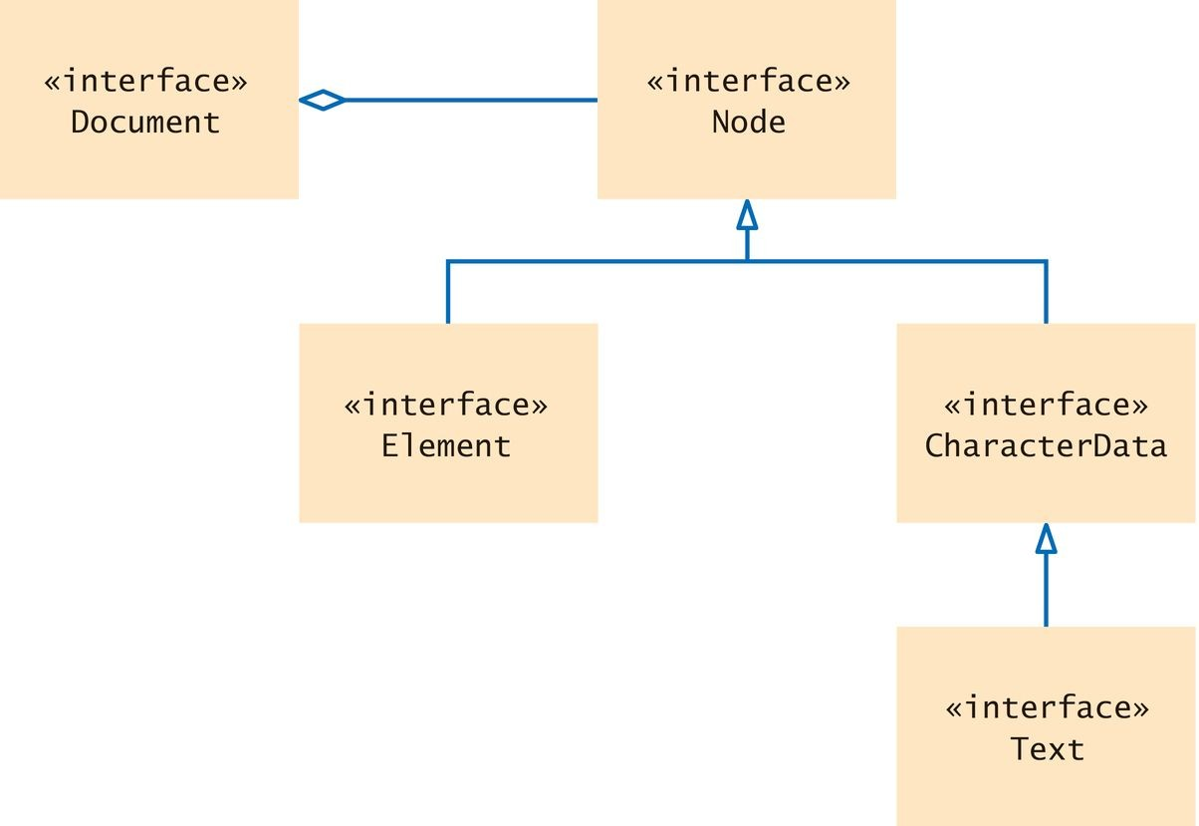
DOM Interfaces for XML Document Nodes
Figure 3 UML Diagram of DOM Interfaces Used in This Chapter

Slide 39
Creating XML Documents - Helpers
To construct the tree structure of a document, it is a good idea to use a set of helper methods.
Helper method to create an element with text:
private Element createTextElement(String name, String text)
{
Text t = doc.createTextNode(text); Element e = doc.createElement(name); e.appendChild(t);
return e;
}
To construct a price element:
Element priceElement = createTextElement("price”, "29.95");

Slide 40
Creating XML Documents - Product Element
Helper method to create a product element from a Product object:
private Element createProduct(Product p)
{
Element e = doc.createElement("product"); e.appendChild(createTextElement("description",
p.getDescription())); e.appendChild(createTextElement("price", "" +
p.getPrice())); return e;
}

Slide 41
Creating XML Documents - Item Element
createProduct is called from createItem:
private Element createItem(LineItem anItem)
{
Element e = doc.createElement("item"); e.appendChild(createProduct(anItem.getProduct())); e.appendChild(createTextElement( "quantity",
"" + anItem.getQuantity())); return e;
}

Slide 42
Creating XML Documents - Items
Helper method createItems is implemented in the same way.
private Element createItems(ArrayList<LineItem> items)
Build the document:
ArrayList<LineItem> items = ...; doc = builder.newDocument(); Element root = createItems(items); doc.appendChild(root);

Slide 43
Creating XML Documents - Writing
There are several ways of writing an XML document. We use the LSSerializer interface.
Obtain an LSSerializer with the following “magic incantation”:
DOMImplementation impl = doc.getImplementation(); DOMImplementationLS implLS =
(DOMImplementationLS) impl.getFeature("LS", "3.0"); LSSerializer ser = implLS.createLSSerializer();
Then simply use the writeToString method:
String str = ser.writeToString(doc);
The LSSerializer produces an XML document without spaces or line breaks.
To nicely format the XML document, set this option after creating the serializer:
ser.getDomConfig().setParameter("format-pretty-print", true);

Slide 44
section_3/ItemListBuilder.java
import java.util.ArrayList;
import javax.xml.parsers.DocumentBuilder;
import javax.xml.parsers.DocumentBuilderFactory;
import javax.xml.parsers.ParserConfigurationException;
import org.w3c.dom.Document;
import org.w3c.dom.Element;
import org.w3c.dom.Text;
8
9
10
11
12
13
14
15
16
17
18
19
20
21
22
23
24
25
26
27
28
29
30
31
32
33
34
35
/**
Builds a DOM document for an array list of items.
*/
public class ItemListBuilder
{
private DocumentBuilder builder; private Document doc;
/**
Constructs an item list builder.
*/
public ItemListBuilder()
throws ParserConfigurationException
{
DocumentBuilderFactory factory
= DocumentBuilderFactory.newInstance(); builder = factory.newDocumentBuilder();
}
/**
Builds a DOM document for an array list of items.
@param items the items
@return a DOM document describing the items
*/
public Document build(ArrayList<LineItem> items)
{
doc = builder.newDocument();

Slide 45
section_3/ItemListBuilderDemo.java
import java.util.ArrayList;
import org.w3c.dom.DOMImplementation;
import org.w3c.dom.Document;
import org.w3c.dom.ls.DOMImplementationLS;
import org.w3c.dom.ls.LSSerializer;
6
7
8
9
10
11
12
13
14
15
16
17
18
19
20
21
22
23
24
25
/**
This program demonstrates the item list builder. It prints the XML file corresponding to a DOM document containing a list of items.
*/
public class ItemListBuilderDemo
{
public static void main(String[] args) throws Exception
{
ArrayList<LineItem> items = new ArrayList<>(); items.add(new LineItem(new Product("Toaster", 29.95), 3));
items.add(new LineItem(new Product("Hair dryer", 24.95), 1));
ItemListBuilder builder = new ItemListBuilder(); Document doc = builder.build(items); DOMImplementation impl = doc.getImplementation(); DOMImplementationLS implLS
= (DOMImplementationLS) impl.getFeature("LS", "3.0"); LSSerializer ser = implLS.createLSSerializer();
String out = ser.writeToString(doc);
26
Program Run:
<?xml version="1.0" encoding="UTF-8"?><items><item><product>
<description>Toaster</description><price>29.95</price></product>
<quantity>3</quantity></item><item><product><description>Hair dryer
</description><price>24.95</price></product><quantity>1</quantity>
</item></items>

Slide 46
Self Check 25.6
Suppose you need to construct a Document object that represents an XML document other than an item list. Which methods from the ItemListBuilder class can you reuse?
Answer: The createTextElement method is useful for creating other documents.

Slide 47
Self Check 25.7
How would you write a document to the file output.xml?
Answer: First construct a string, as described, and then use a
PrintWriter to save the string to a file.

Slide 48
Validating XML Documents
We need to specify rules for XML documents of a particular type. There are several mechanisms for this purpose.
The oldest and simplest mechanism is a Document Type Definition (DTD).

Slide 49
Document Type Definitions
A DTD is a set of rules for correctly formed documents of a particular type.
Describes the valid attributes for each element type. Describes the valid child elements for each element type. Valid child elements are described by an ELEMENT rule:
<!ELEMENT items (item*)>
items element can have 0 or more item elements. Definition of an item node:
<!ELEMENT item (product, quantity)>
Children of the item node must be a product node followed by a
quantity node.

Slide 50
Document Type Definition - Elements
Definition of product node:
<!ELEMENT product (description, price)>
The other nodes:
<!ELEMENT quantity (#PCDATA)>
<!ELEMENT description (#PCDATA)>
<!ELEMENT price (#PCDATA)>
#PCDATA refers to text, called “parsed character data” in XML terminology.
Can contain any characters.
Special characters have to be replaced when they occur in character data.

Slide 51
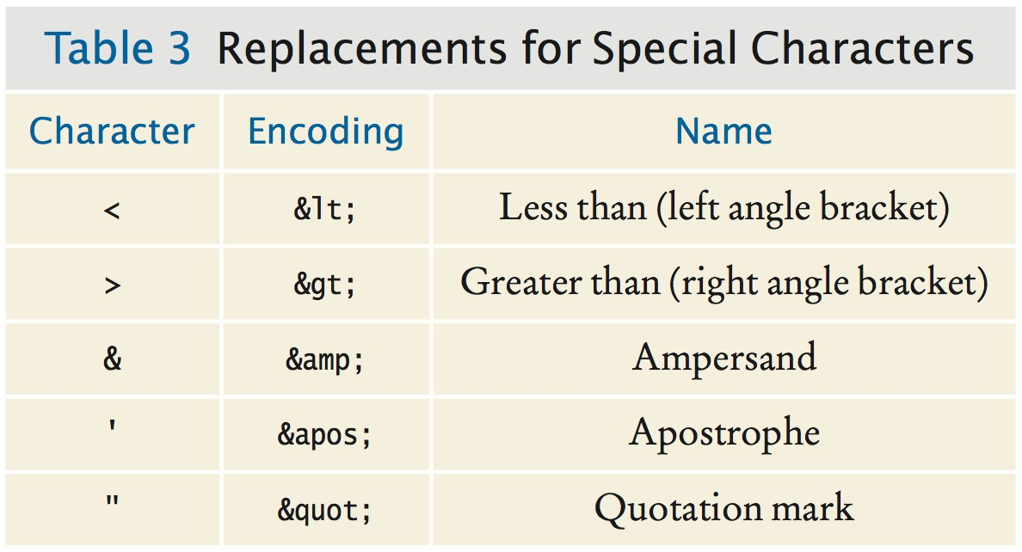
Replacements for Special Characters

Slide 52
Item List DTD
<!ELEMENT items (item)*>
<!ELEMENT item (product, quantity)>
<!ELEMENT product (description, price)>
<!ELEMENT quantity (#PCDATA)>
<!ELEMENT description (#PCDATA)>
<!ELEMENT price (#PCDATA)>

Slide 53
Document Type Definitions - Child Rules
The HTML DTD defines the img element to be EMPTY. An image has only attributes.
More interesting child rules can be formed with the regular expression operations (* + ? , |).

Slide 54
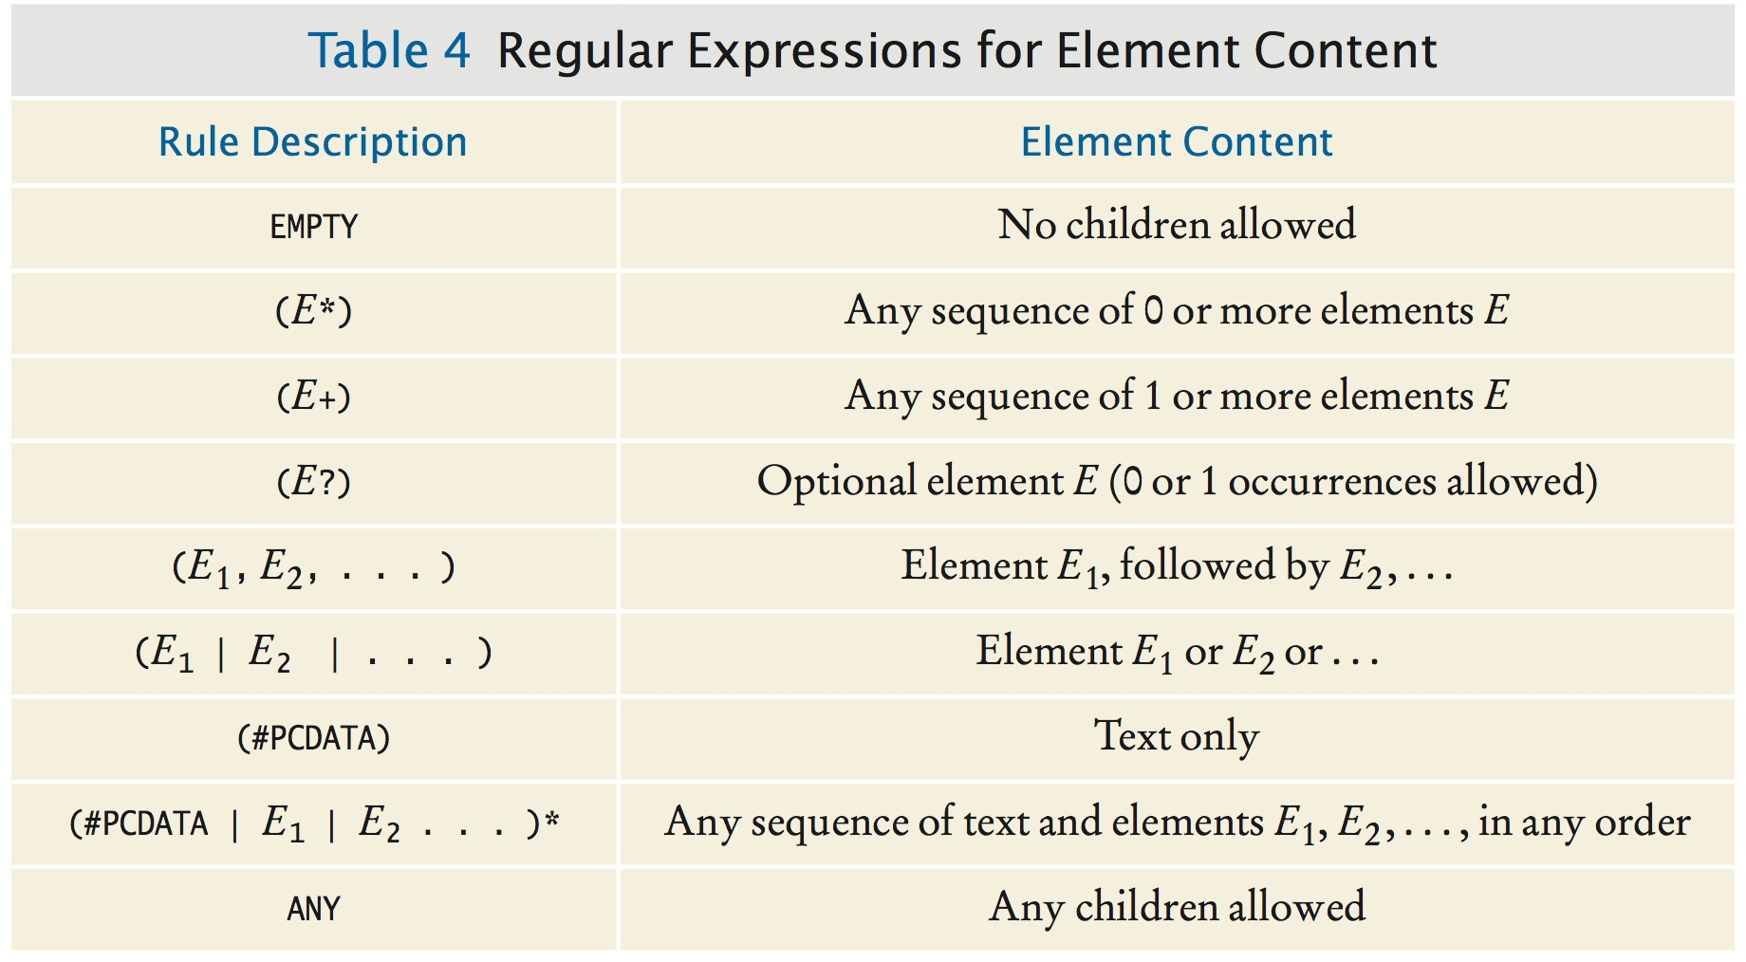
Regular Expressions for Element Content

Slide 55
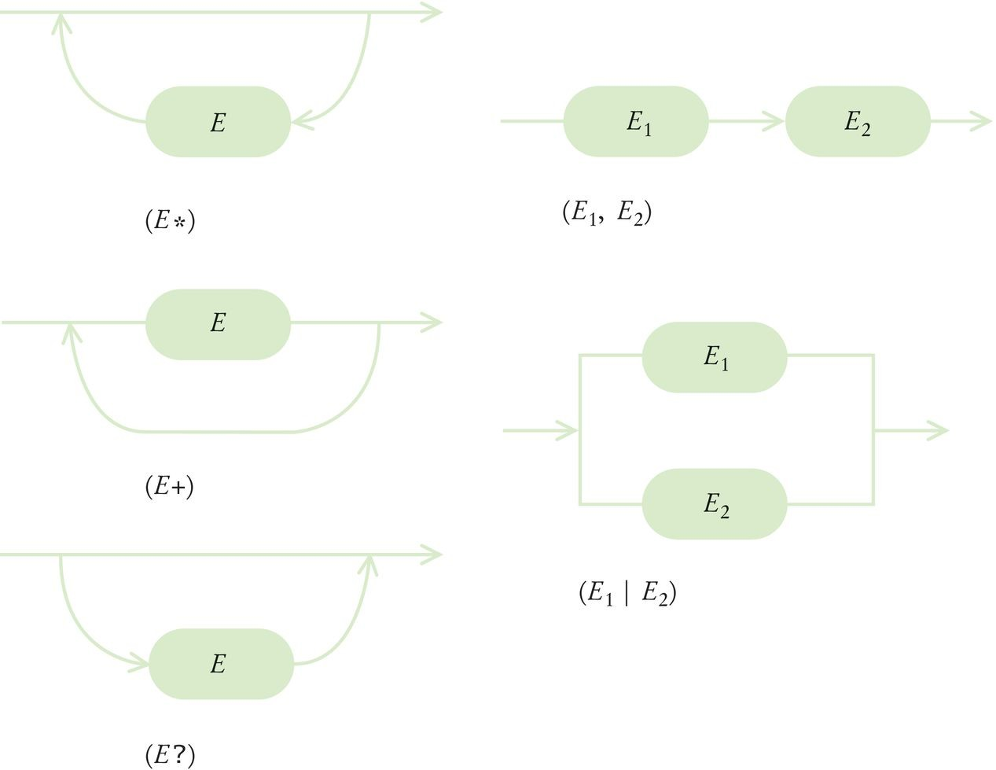
DTD Regular Expression Operations
Figure 5 DTD Regular Expression Operations

Slide 56
DTD Regular Expression Example
Example:
<!ELEMENT section (title, (paragraph | (image, title?))+)>
Defines an element section whose children are:
A title element.
A sequence of one or more of the following:
paragraph elements.
image elements followed by optional title elements.
Thus, the following is not valid because there is no starting title, and the title at the end doesn't follow an image:
<section>
<paragraph/>
<paragraph/>
<title/>
</section>

Slide 57
Document Type Definitions - Attributes
A DTD gives you control over the allowed attributes of an element:
<!ATTLIST Element Attribute Type Default>
Type can be any sequence of character data specified as CDATA. There is no practical difference between CDATA and #PCDATA.

Slide 58
Document Type Definitions - Attributes
Use CDATA in attribute declarations. Use #PCDATA in element declarations.
You can also specify a finite number of choices:
<!ATTLIST price currency (USD | EUR | JPY ) #REQUIRED >
You can use letters, numbers, and the hyphen (-) and underscore (_) for the attribute values.

Slide 59
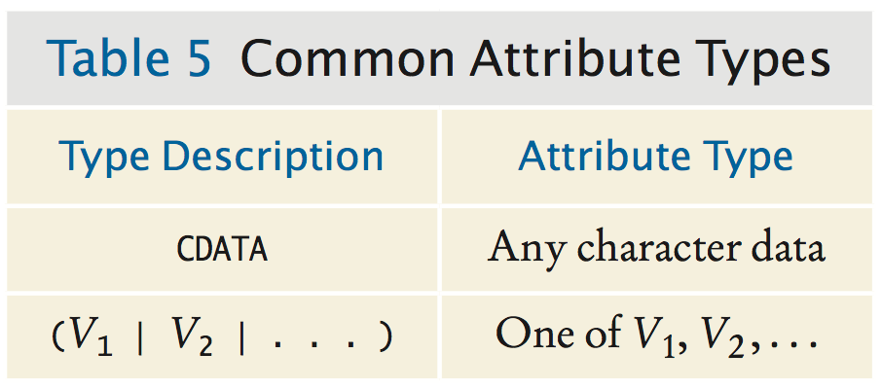
Common Attribute Types

Slide 60
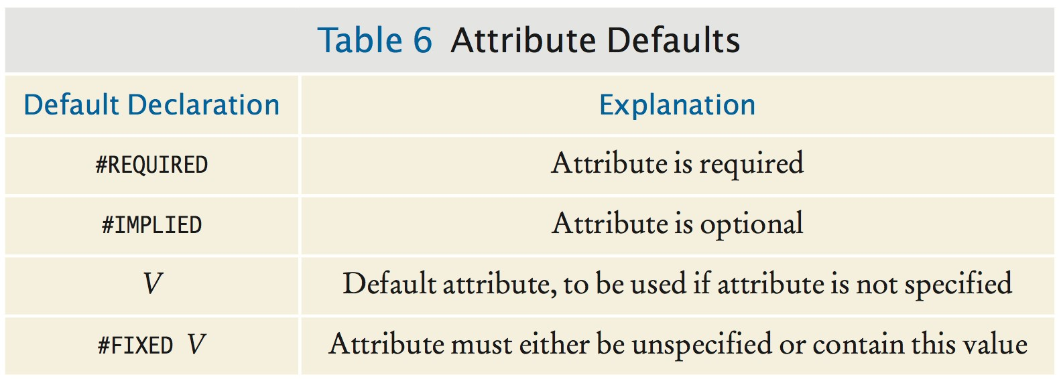
Attribute Defaults

Slide 61
Attributes Rules
#IMPLIED keyword means attribute is optional:
<!ATTLIST price currency CDATA #IMPLIED>
If you omit the attribute, the application processing the XML data implicitly assumes some default value.
You can specify a default to be used if the attribute is not specified:
<!ATTLIST price currency CDATA "USD">
To state that an attribute can only be identical to a particular value:
<!ATTLIST price currency CDATA #FIXED "USD">

Slide 62
Specifying a DTD in an XML Document
An XML document can reference a DTD in one of two ways:
The document may contain the DTD.
The document may refer to a DTD stored elsewhere.
A DTD is introduced with the DOCTYPE declaration.
If the document contains its DTD, the declaration looks like this:
<!DOCTYPE rootElement [ rules ]>

Slide 63
Example: An Item List
<?xml version="1.0"?>
<!DOCTYPE items [
<!ELEMENT items (item*)>
<!ELEMENT item (product, quantity)>
<!ELEMENT product (description, price)>
<!ELEMENT quantity (#PCDATA)>
<!ELEMENT description (#PCDATA)>
<!ELEMENT price (#PCDATA)>
]>

Slide 64
Example: An Item List (cont.)
<items>
<item>
<product>
<description>Ink Jet Refill Kit</description>
<price>29.95</price>
</product>
<quantity>8</quantity>
</item>
<item>
<product>
<description>4-port Mini Hub</description>
<price>19.95</price>
</product>
<quantity>4</quantity>
</item>
</items>

Slide 65
Specifying a DTD in an XML Document
If the DTD is more complex, it is better to store it outside the XML document.
Use the SYSTEM keyword for a file:
<!DOCTYPE items SYSTEM "items.dtd">
Or the resource can be a URL anywhere on the Web:
<!DOCTYPE items SYSTEM
"http://www.mycompany.com/dtds/items.dtd">
The DOCTYPE declaration can contain a PUBLIC reserved word:
<!DOCTYPE faces-config PUBLIC
"-//Sun Microsystems, Inc.//DTD JavaServer Faces Config 1.0//EN" "http://java.sun.com/dtd/web-facesconfig_1_0.dtd">
If the public identifier is familiar, the program parsing the document need not spend time retrieving the DTD.

Slide 66
Parsing and Validation
When your XML document has a DTD, you can request validation when parsing.
The parser will check that all child elements and attributes conform to the ELEMENT and ATTLIST rules in the DTD.
The parser reports an error if the document is invalid.
Use the setValidating method of the DocumentBuilderFactory before calling newDocumentBuilder method:
DocumentBuilderFactory factory = DocumentBuilderFactory.newInstance();
factory.setValidating(true);
DocumentBuilder builder = factory.newDocumentBuilder(); Document doc = builder.parse(...);

Slide 67
Enabling DTD while Parsing
When you parse an XML file with a DTD, tell the parser to ignore white space:
factory.setValidating(true); factory.setIgnoringElementContentWhitespace(true);
If the parser has access to a DTD, it can fill in defaults for attributes.

Slide 68
Parsing with DTDs - Default Attribute Values
For example, suppose a DTD defines a currency attribute for a price element:
<!ATTLIST price currency CDATA "USD">
If a document contains a price element without a currency attribute, the parser can supply the default:
String attributeValue = priceElement.getAttribute("currency”);
// Gets "USD" if no currency specified

Slide 69
Self Check 25.8
How can a DTD specify that the quantity element in an item is optional?
Answer:
<!ELEMENT item (product, quantity?)>

Slide 70
Self Check 25.9
How can a DTD specify that a product element can contain a description and a
price element, in any order?
Answer:
<!ELEMENT product ((description, price) | (price, description))>

Slide 71
Self Check 25.10
How can a DTD specify that the description element has an optional attribute
language?
Answer:
<!ATTLIST description language CDATA #IMPLIED>

